Slide 1
SQL Server 2000 Internals
Indexes – Part I
Ramkumar Murugesan

Slide 2
SQL Server Indexes
Index Organization
Retrieving rows
Structure of Index Rows
Types of Index Pages
Clustered Index with Uniqueifier
Exercises
Notes:
adfasdfsadfsda

Slide 3
Next Section>>>
Index Organization
Topics…
B-Trees | Arrangement of data in pages | Clustered Indexes | Non-Clustered Indexes

Slide 4
Index Organization
Indexes store their information using B-Trees (Balanced Tree)
B-tree groups records with similar index keys
Fast retrieval of data happens by searching on a key value
Branches of the index tree are spliced together or split apart for
  Searching any record always traverses the same number of levels
  Accessing the same number of pages for any record
The traversal begins at the root page, progresses to intermediate index levels, and moves to bottom-level pages called leaf pages
The index is used to find the correct leaf page

Slide 5
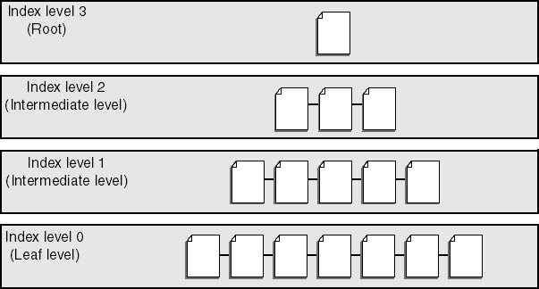
Index Organization
Figure: A Sample B-Tree

Slide 6
Index Organization
An index is organized in a B-tree format with a root, possible intermediate index levels, and bottom-level leaf pages
The number of intermediate levels in an index will vary depending on the number of rows in the table and the size of the key column or columns for the index
The leaf page will be the lowest page of the tree in which one or more rows with the specified key or keys reside
In any index, whether clustered or non-clustered, the leaf level contains every key value, in key sequence
For indexes with large key, fewer entries will fit on a page, so more pages (and possibly more levels) will be needed for the index
Notes:
adfasdfsadfsda

Slide 7
Index Organization
SQL Server maintains ordering in index leaf levels
Unloading and Reloading data is not necessary to maintain clustering properties as data is added and moved
SQL Server always inserts rows into the correct page in clustered sequence
For a clustered index, the correct leaf page is the data page in which a row is inserted
For a non-clustered index, the correct leaf page is the one into which SQL Server inserts a row containing the key value (and bookmark) for the newly inserted row

Slide 8
Clustered Index Organization
The leaf level of a clustered index contains the data pages
A clustered index keeps the data in a table ordered around the key
The data pages in the table are kept in a doubly linked list called the page chain
The order of pages in the page chain, and the order of rows on the data pages, is the order of the index key or keys
In SQL Server 2000, all clustered indexes are unique by default
For Clustered indexes built without specifying the unique keyword, SQL Server forces uniqueness by adding a uniqueifier to the rows when necessary
Notes:
adfasdfsadfsda

Slide 9
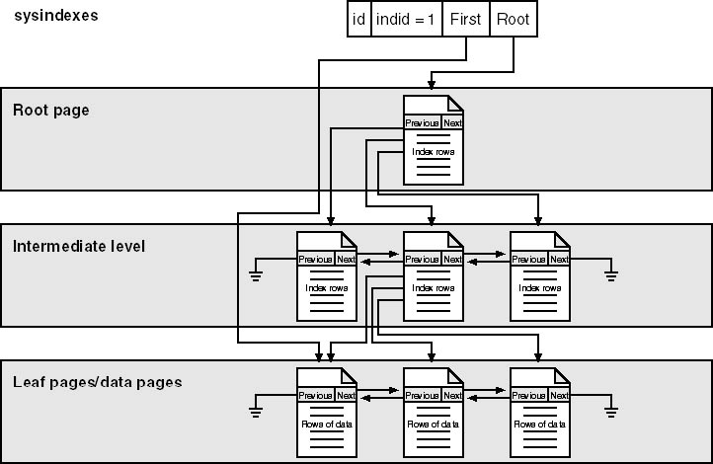
Clustered Index Organization

Slide 10
Non-Clustered Index Organization
In a non-clustered index, the leaf level contains a bookmark that tells SQL Server where to find the data row corresponding to the key in the index
Every other pages are similar to that of Clustered Index
Bookmark can be a
  Clustered index key, if table is clustered
  RID (File#:Page#:Slot#), if table is a heap
Each table can include 249 non-clustered indexes, as data in a table is not organized on a non-clustered index

Slide 11
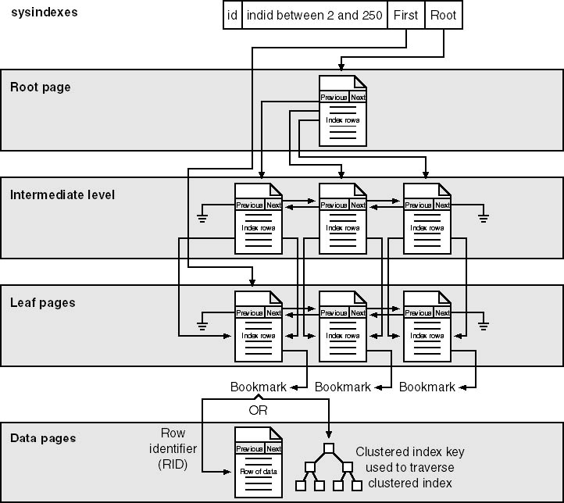
Non-Clustered Index Organization

Slide 12
Next Section>>>
Retrieving Rows
Topics…
Retrieving rows in heap | Retrieving rows in a heap using NCI | Retrieving rows in CI using NCI

Slide 13
Retrieving rows in a heap
sysindexes
id
indid = 0
First IAM
IAM
Extent Bit Map
…
127 1
128 1
129 0
130 1
…
Heap
Extent 127
Extent 128
Extent 129
Extent 130
01
Con
…
01
Dusza
…
01
Seattle
…
01
Graff
…
01
Rusko
…
01
Rusko
…
01
Rusko
…
01
Rusko
…
02
01
Arifin
…
01
Arifin
…
01
Arifin
…
01
Arifin
…
01
Funk
Smith
…
…
02
01
Randall
Smith
…
…
02
01
Paris
Smith
…
…
02
01
Bacon
Smith
02
01
…
…
Wu
Con
…
…
02
01
Wu
Con
…
…
02
01
Wu
Con
…
…
02
01
Wu
Con
02
01
…
…
Funk
Rusko
…
…
02
01
Funk
Rusko
…
…
02
01
Funk
Rusko
…
…
02
01
Funk
Rusko
03
02
…
…
Wu
01
Ortiz
Arifin
…
…
…
03
02
Ortiz
01
Ortiz
Arifin
…
…
…
03
02
Tokyo
01
Ortiz
Arifin
…
…
…
03
02
Koch
01
Ortiz
Arifin
03
02
…
…
…
Barr
01
Funk
Smith
…
…
…
03
02
Barr
01
Funk
Smith
…
…
…
03
02
Barr
01
Funk
Smith
…
…
…
03
02
Barr
01
Funk
Smith
03
02
…
…
…
Smith
Wu
…
…
03
02
Smith
Wu
…
…
03
02
Smith
Wu
…
…
03
02
Smith
Wu
04
03
…
…
Duerr
02
Jones
Funk
…
…
04
03
Seidl
02
Jones
Funk
…
…
04
03
Atlanta
02
Jones
Funk
…
…
…
03
02
Jones
Funk
…
03
02
…
…
Wu
Ortiz
…
…
…
03
02
Wu
Ortiz
…
…
…
03
02
Wu
Ortiz
…
…
…
03
02
Wu
Ortiz
04
03
…
…
Martin
Barr
…
04
03
Martin
Barr
…
04
03
Martin
Barr
…
04
03
Martin
05
…
Barr
…
Lang
03
…
Smith
…
05
…
LaMee
03
…
Smith
…
…
…
03
…
Smith
…
…
…
03
…
…
…
03
Jones
…
…
…
03
Jones
…
…
…
03
Jones
…
…
…
03
Smith
…
…
…
…
…
…
…
…
…
Jones
…
…
04
Martin
…
04
Martin
…
04
Martin
…
04
Martin
…
…
…
…
…
…
…
…
…
…
…
…
…
…
…
…
…
…
…
…
…
…
…
…

Slide 14
Retrieving rows in a heap using Non-clustered Index
sysindexes
sysindexes
id
indid = 2
root
id
indid = 2
root
Non
clustered
index
Non
Clustered
Index
Non-leaf
level
Non-Leaf
Level
Arifin
Arifin
SELECT lastname, firstname
FROM member
WHERE lastname
BETWEEN 'Masters' AND 'Rusko'
Martin
Martin
Martin
Page 37
Martin
Page 28
Page 37
Page 12 - Root
Page 28
Page 12 - Root
Arifin
Martin
Arifin
Martin
Martin
Martin
Ganio
Smith
Ganio
Smith
Leaf level
(Key value)
Leaf Level
(Key Value)
Page 41
Page 51
Page 61
Page 71
Page 41
Page 51
Page 61
Page 71
Arifin
4:706:01
Ganio
4:709:01
Martin
4:708:01
Smith
4:706:03
Arifin
4:706:01
Ganio
4:709:01
Martin
4:708:01
Smith
4:706:03
Manek
4:706:04
Barr
4:705:03
Hall
4:709:04
Manek
4:706:04
Barr
4:705:03
Hall
4:709:04
Manek
4:706:04
Smith
4:708:04
Manek
4:706:04
Smith
4:708:04
Con
4:704:01
Jones
4:709:02
Ortiz
4:707:02
Smith
4:707:01
Con
4:704:01
Jones
4:709:02
Ortiz
4:707:02
Smith
4:707:01
Ortiz
4:707:02
Ortiz
4:707:02
Funk
4:706:02
Jones
4:708:03
Pike
4:708:02
Wu
4:704:03
Funk
4:706:02
Jones
4:708:03
Pike
Pike
Pike
4:708:02
4:708:02
4:708:02
Wu
4:704:03
Funk
4:704:02
Jones
4:707:03
Rusko
Rusko
4:705:01
Funk
4:704:02
Jones
4:707:03
Rusko
4:705:01
Wu
4:705:02
Rusko
4:705:01
4:705:01
Wu
4:705:02
Heap
Heap
Page 704
Page 705
Page 706
Page 707
Page 704
Page 705
Page 706
Page 707
Page 708
Page 709
Page 708
Page 709
01
Con
01
01
Rusko
01
Con
01
Rusko
01
Arifin
01
Smith
01
Martin
01
Ganio
01
Rusko
Rusko
01
Arifin
01
Smith
01
Martin
01
Ganio
02
Ortiz
02
Funk
02
Wu
02
Funk
02
Ortiz
02
Funk
02
Wu
02
Funk
02
Ortiz
02
Pike
02
Jones
02
Ortiz
02
02
02
Pike
Pike
Pike
02
Jones
03
Wu
03
Barr
03
Smith
03
Jones
03
Jones
03
Hall
03
Wu
03
Barr
03
Smith
03
Jones
03
Jones
03
Hall
04
Manek
04
Manek
04
Manek
04
Smith
04
Manek
04
Smith

Slide 15
Retrieving Rows in a Clustered Index
sysindexes
sysindexes
id
id
indid = 1
indid = 1
root
root
Clustered Index
Clustered index
Arifin
Arifin
…
…
Martin
Martin
Martin
Martin
Page 140 - Root
Page 140 - Root
SELECT lastname, firstname
FROM member
WHERE lastname = 'Ortiz'
Arifin
Martin
Arifin
Martin
Martin
Martin
Ganio
Smith
Ganio
Smith
…
…
…
…
Page 141
Page 141
Page 145
Page 145
Arifin
2334
Ganio
7678
Martin
1234
Smith
1434
Arifin
2334
Ganio
7678
Martin
1234
Smith
1434
Barr
5678
Hall
8078
Martin
7778
Smith
5778
Barr
5678
Hall
8078
Martin
7778
Smith
5778
Con
2534
Jones
2434
Ortiz
5878
Smith
7978
Con
2534
Jones
2434
Ortiz
5878
Smith
7978
Ortiz
5878
Ortiz
5878
Funk
1334
Jones
5978
Pike
7878
Wu
2234
Funk
1334
Jones
5978
Pike
7878
Wu
2234
Funk
1534
Jones
2634
Rusko
6078
Wu
1634
Funk
1534
Jones
2634
Rusko
6078
Wu
1634
Page 100
Page 100
Page 110
Page 110
Page 120
Page 120
Page 130
Page 130

Slide 16
Next Section>>>
Structure of an Index Page
Topics…
Difference between index and data pages | Page Header | Index Row Format

Slide 17
Structure of Index Page
Like other pages in SQL Server, index pages have a fixed size of 8 KB, or 8192 bytes
Index pages also have a 96-byte header and an offset array to indicate the offset of that row on the page
indid in sysindexes table would tell the type of the index created
  A value of 1 denotes a clustered index
  A number between 2 and 250, indicates a non-clustered index
  A Value of 255 indicates LOB data (text, ntext or image information)

Slide 18
Structure of Index Page
The root column value contains a file number and page number where the root of the index can be found
The header information for index pages is almost identical to those of data pages
The Differences between a data and index page are…
  The Value for type is 2 for index pages, where as it is 1 for data pages
  The header of an index page also has nonzero values for level and indexId
  For data pages, these values are always 0

Slide 19
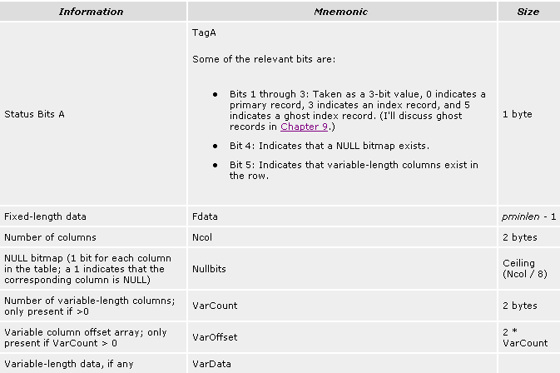
Index Row format
Figure above: Information stored in a index row
Structure of Data Row

Slide 20
Index Row format
The row structure of an index entry is very similar to the structure of a data row
The data contents of an index row depend on the level of the index
All rows except those in the leaf level contain a 6-byte down-page pointer in addition to the key values and bookmarks
If the bookmark is a clustered key value, and the clustered and non-clustered indexes share columns, the actual data is stored only once
For example, if your clustered index key is lastname and you have a non-clustered index on (firstname, lastname), the index rows will not store the value of lastname twice
Notes:
The down-page pointer is the last column in the fixed-data portion of the row

Slide 21
Next Section>>>
Types of Index Pages
Topics…
CI Node Pages | CI Leaf Pages | NCI Node Pages | NCI Leaf Pages

Slide 22
Types of Index Pages
Different types of index pages…
  Node level (non-leaf) pages for clustered indexes
  Leaf level pages for clustered indexes - Data Pages
  Node level pages for non-clustered indexes
  Leaf level pages for non-clustered indexes

Slide 23
Types of Index Pages
Clustered Index Node Pages
  The node levels of a clustered index contain pointers to pages at the next level down in the index, along with the first key value on each page pointed to
  Page pointers are 6 bytes: 2 bytes for the file number and 4 bytes for the page number in the file
Non-clustered Index Leaf Pages
  The rows in the leaf level of a non-clustered index contain every key value and a bookmark

Slide 24
Types of Index Pages
non-clustered Index Node Pages
  The non-leaf levels of a non-clustered index only need to help us traverse down to pages at the lower levels
  If the non-clustered index is unique, the node rows need to have only the non-clustered key and the page-down pointer
  If the index is not unique, the row contains key values, a down-page pointer, and a bookmark
Clustered Index Leaf Pages
  Data pages of the table

Slide 25
Next Section>>>
Clustered Index with Uniqueifier
Topics…
Unique Property | Example

Slide 26
Clustered Index with Uniqueifier
When clustered index was created without the UNIQUE property, SQL Server adds a 4-byte field to make each key unique
SQL Server adds the Uniqueifier only when necessary - that is, when duplicates are added to the table
Else no Uniqueifier is added to the clustered indexes
Since clustered index keys are used as bookmarks to identify the base rows being referenced by non-clustered indexes, there needs to be a unique way to refer to each row in a clustered index
The column called keycnt, indicates the number of keys an index has

Slide 27
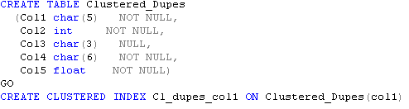
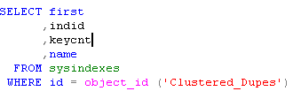

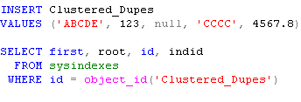

Example – CI with Uniqueifier
The column keycnt indicates the number of keys, the index has
0 – Table is heap
1 – Clustered index with unique qualifier
2 - Clustered index without unique qualifier
first column points the first page of the table
root column points to the root page of the index

Slide 28
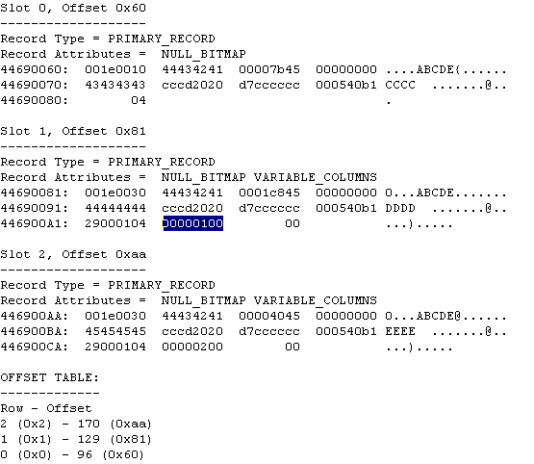
Example – CI with uniqueifier
Structure of a Row
Description of a Row
Detailed Analysis

Slide 29
Next Section>>>
Exercises
Topics…
CI Node Root Pages | CI Node Intermediate Pages | Exercises for you

Slide 30
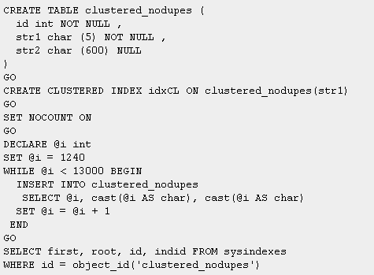
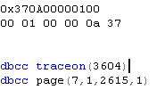
Exercise – CI Node Rows

Slide 31
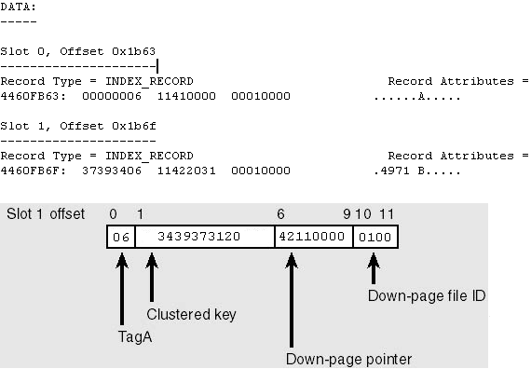
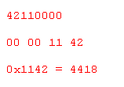
Exercise – CI Node Rows
Figure Above: Structure of a root page of an CI index

Slide 32
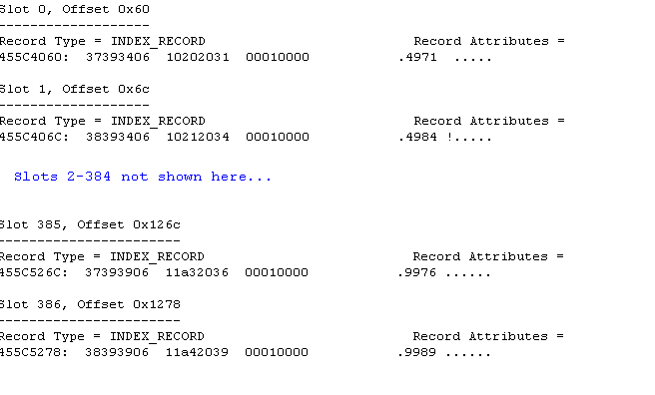
Exercise – CI Node Rows
Figure Above: Structure of intermediate level index pages

Slide 33
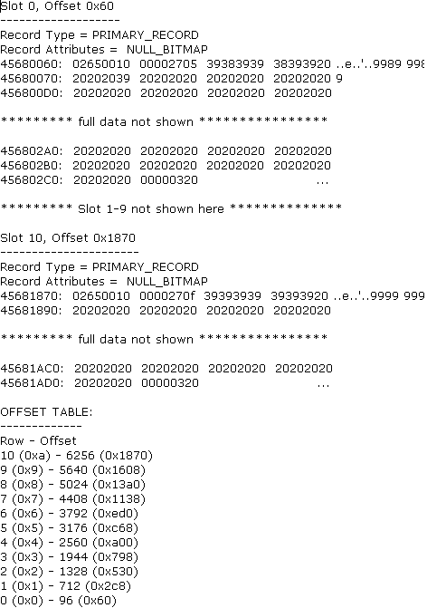
Figure: Structure of a leaf level node in a clustered index

Slide 34
Exercise for you…
Decode the contents of
  Non-Clustered index leaf pages
  Non-Clustered index node pages

Slide 35
End of Topic – Indexes Part I
?

Slide 36
End of Topic – Indexes Part I
Thank you
Next Topic
Architecture Components | Storage Concepts | Transaction Logs | Indexes I | Indexes II | Locking I | Locking II | Query Processor

Slide 37
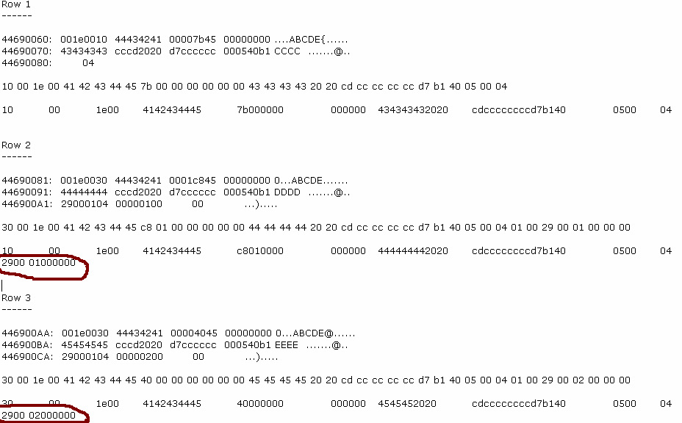
Detailed Analysis – CI with Uniqueifier
Back

